Slide 1
Kinematic Equations for Two-Dimensional Motion
When the two-dimensional motion has a constant acceleration, a series of equations can be developed that describe the motion.
These equations will be similar to those of one-dimensional kinematics.
Motion in two dimensions can be modeled as two independent motions in each of the two perpendicular directions associated with the x and y axes.
Any influence in the y direction does not affect the motion in the x direction and vice versa.

Slide 2
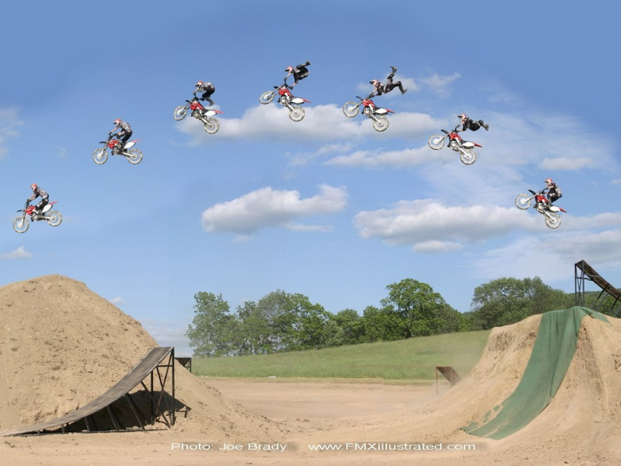
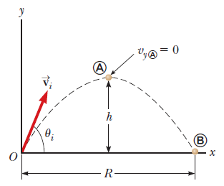
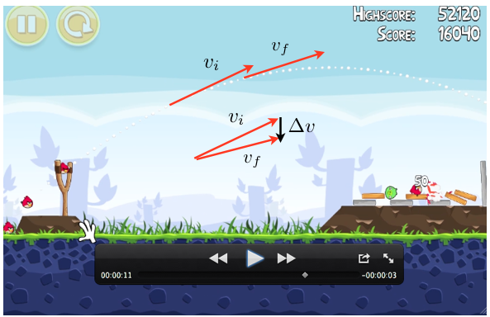
Projectile Motion
Projectile motion is the trajectory obtained when an object is thrown with some initial velocity at some angle and then moves under the influence of gravity alone.
Section 4.3

Slide 3
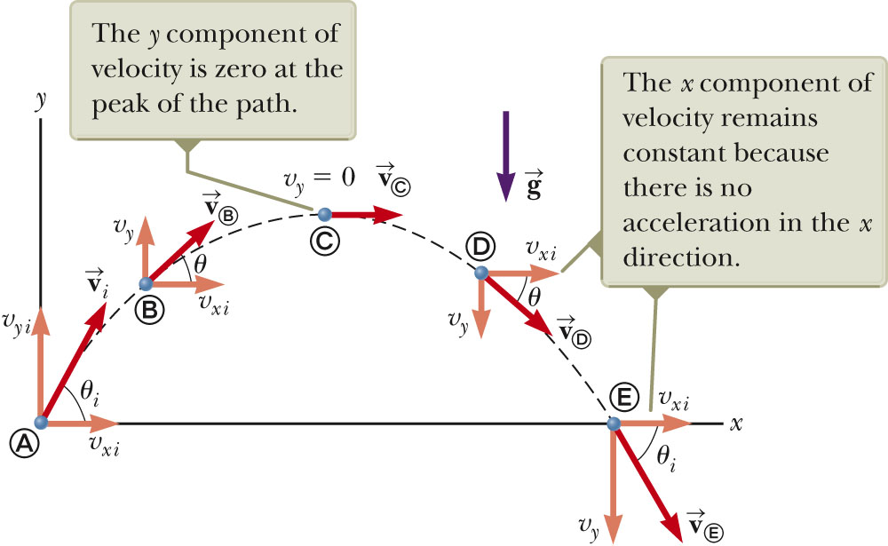
Projectile Motion
What is the acceleration at the highest point?
Maximum height, h
Range, R
We are most interested in calculating h & R.

Slide 4

Projectile Motion Diagram
As mentioned before, motion in two dimensions can be modeled as two independent motions in each of the two perpendicular directions associated with the x and y axes, but the total times for the two motions are the same.
Consider the motion in y-direction from point A to point C:

Slide 5
Projectile Motion Diagram
Consider the motion in x-direction from point a to point E:

Slide 6
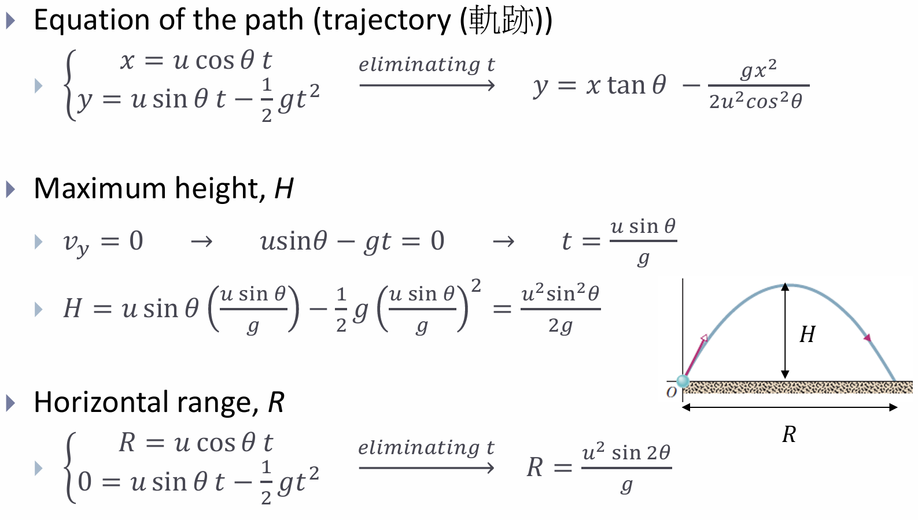
Projectile Motion

Slide 7
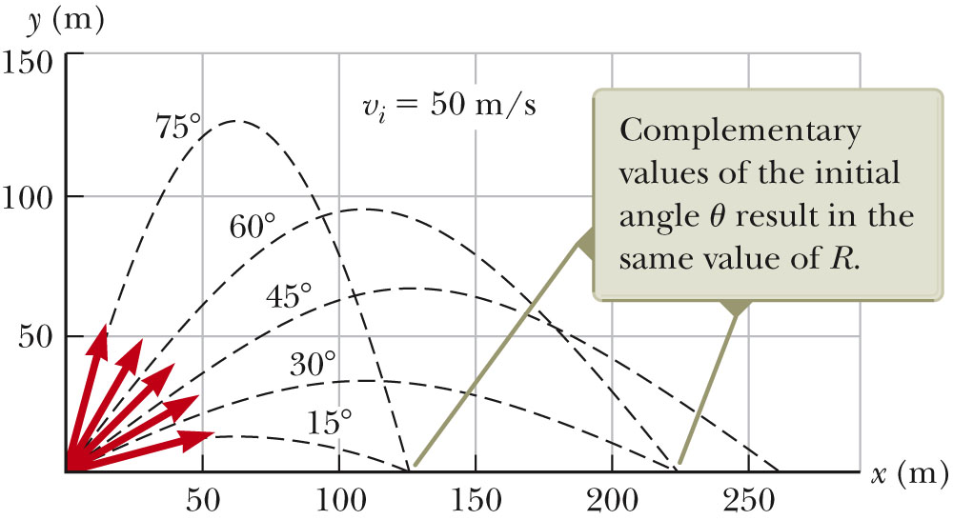
More About the Range of a Projectile
These two equations are valid only for symmetric motion. Use kinematic equations for other cases.

Slide 8
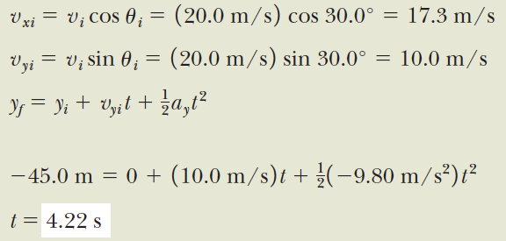
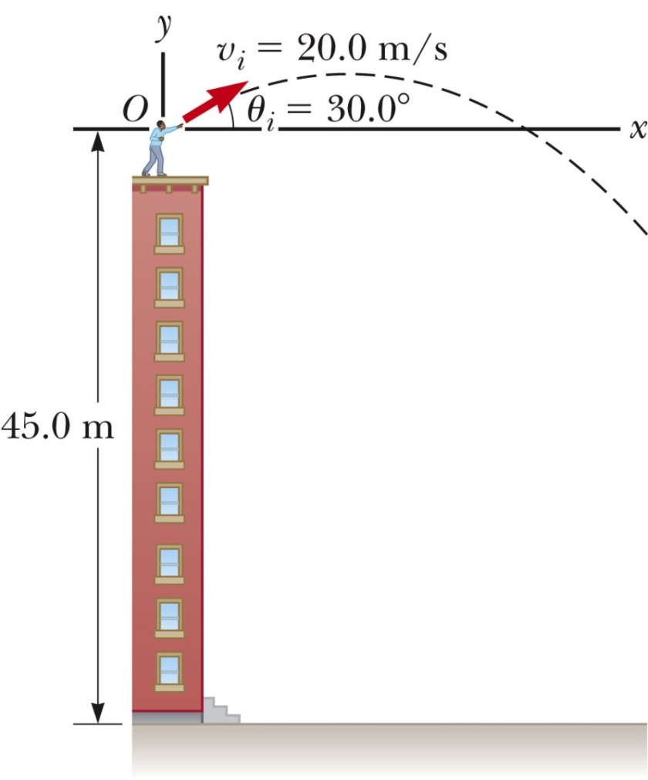
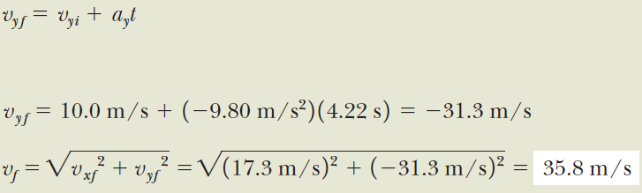

Slide 9

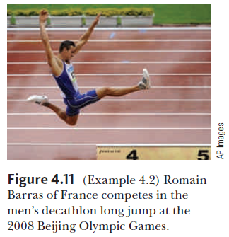



Slide 10
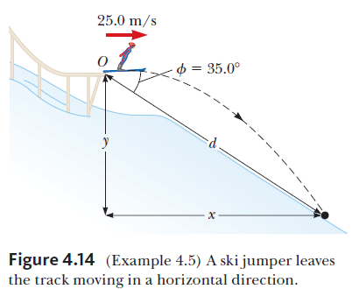






Slide 11
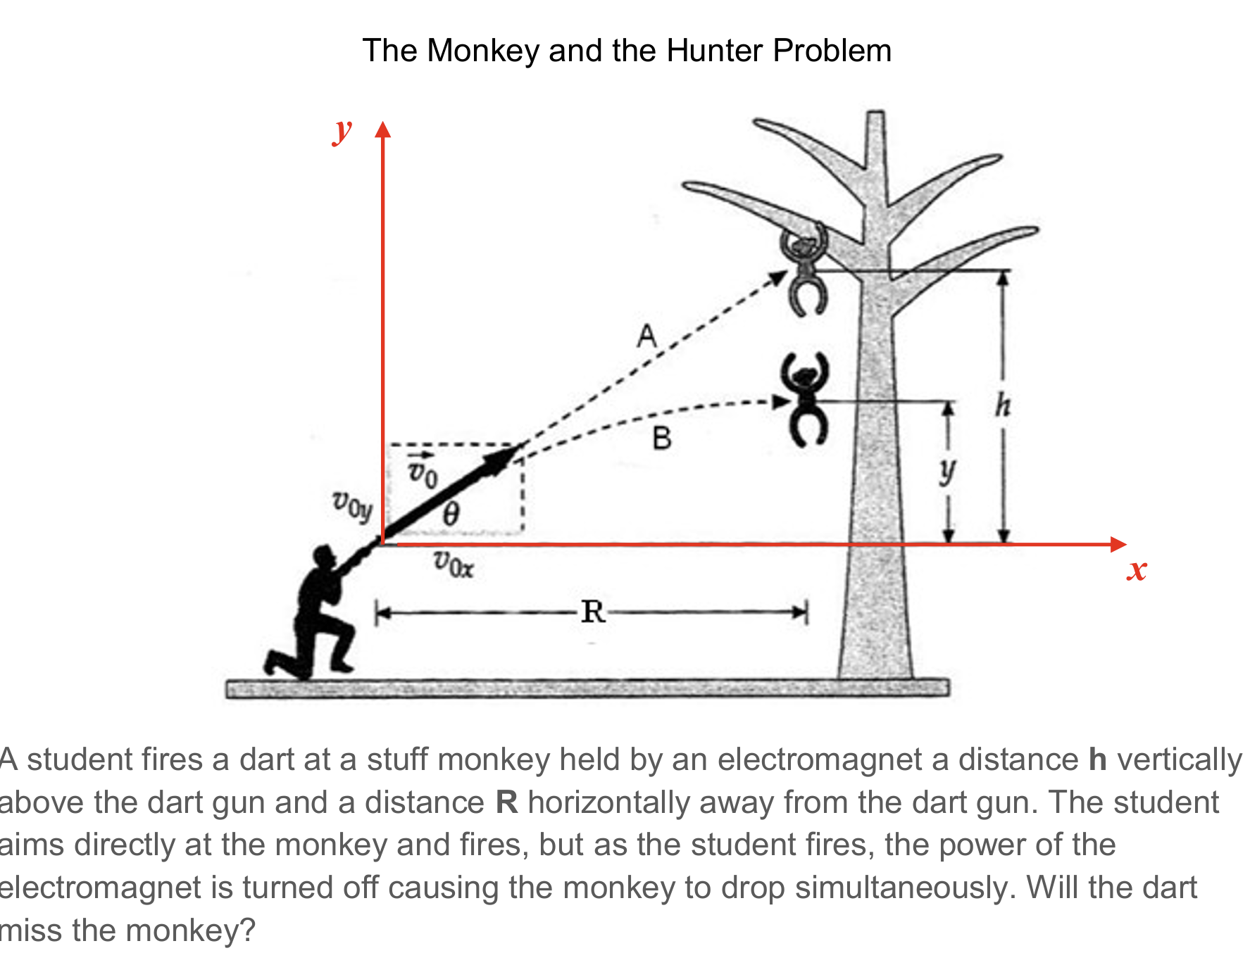
Shoot the Monkey

Slide 12
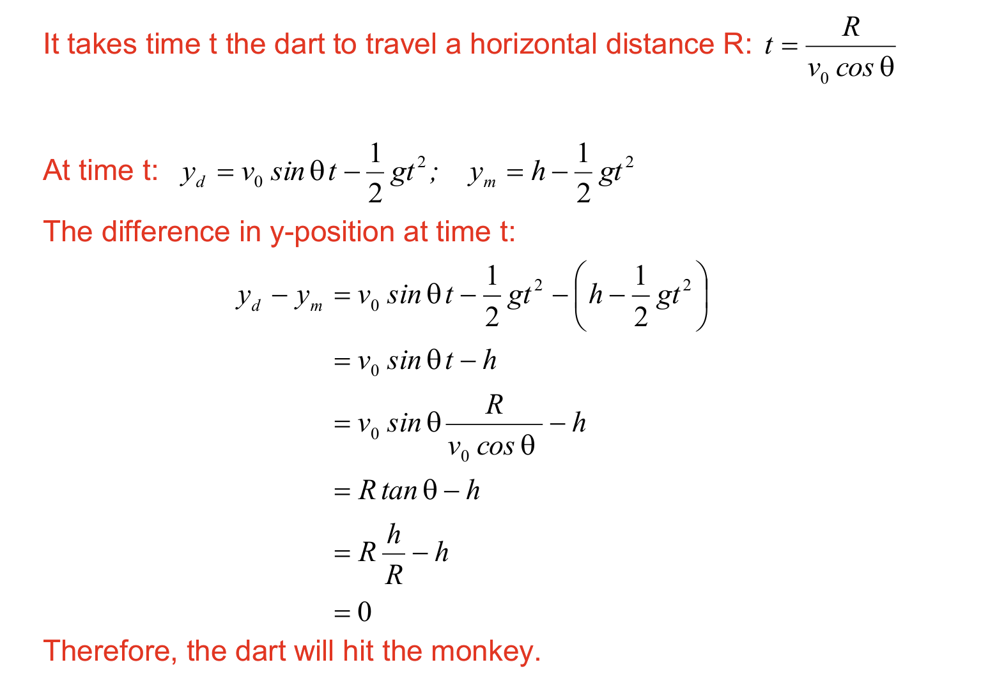

Slide 13
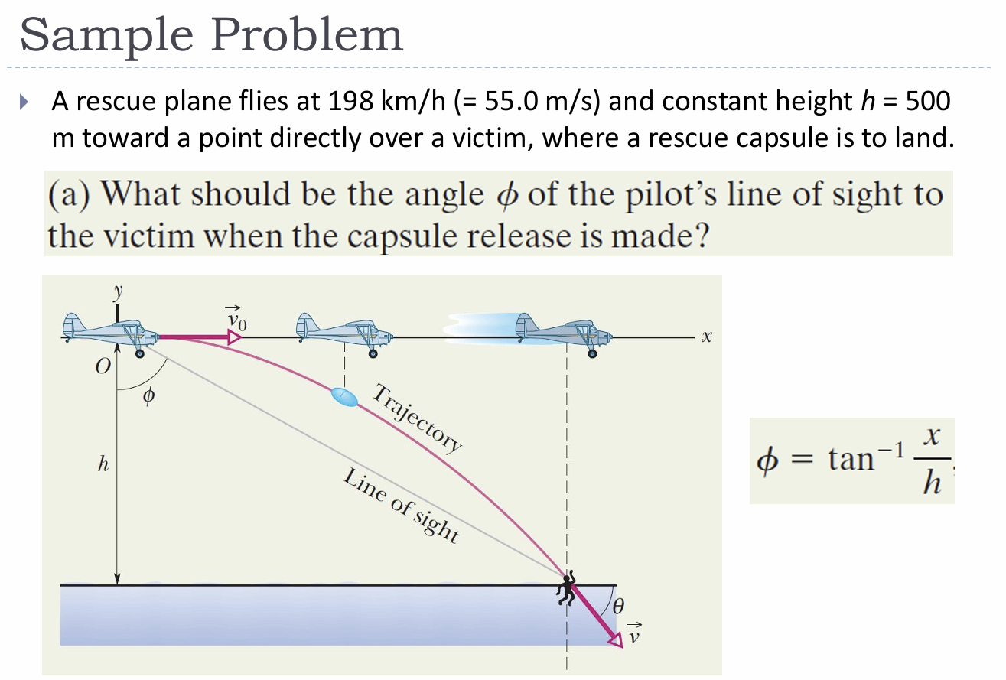

Slide 14
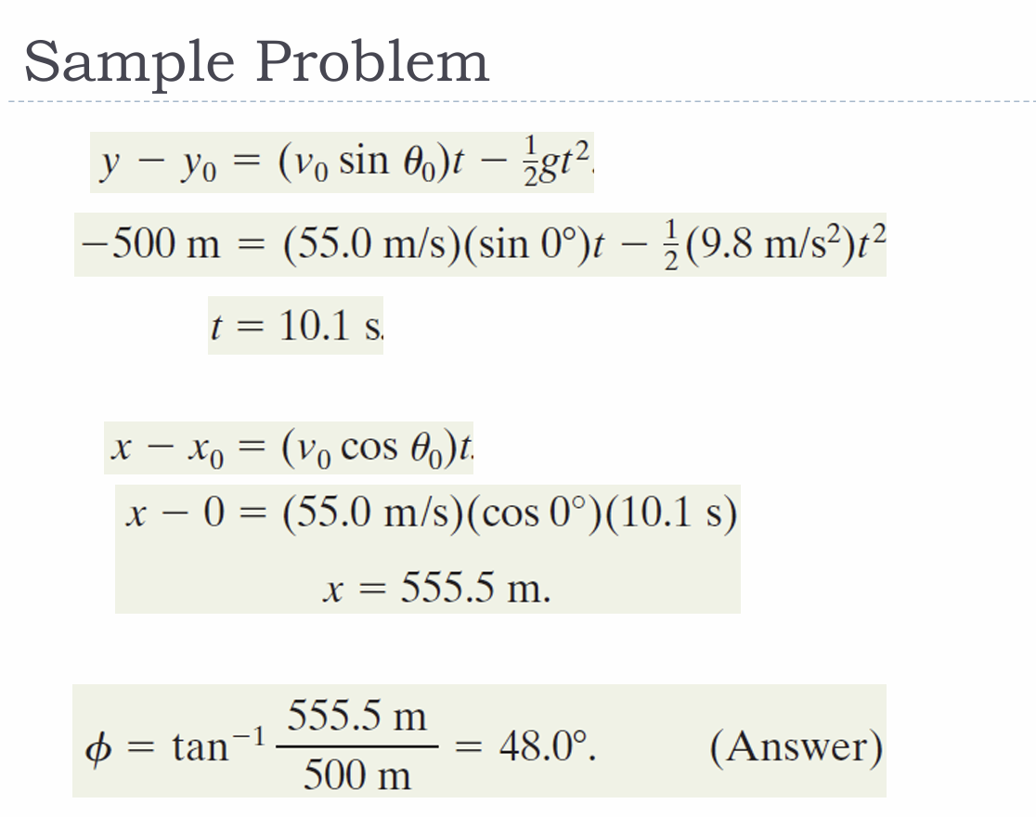

Slide 15

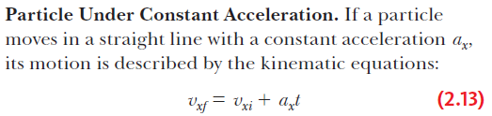

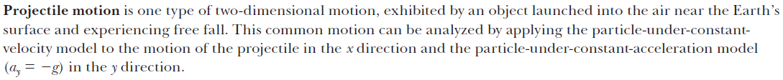
Motion in 1-D
Motion in 2-D

